Slide 1


PRAANA
PRE ANAMNESIS
CHATBOT
Notes:
Opening Hook:
"Imagine if every medical consultation could start with the doctor already knowing your complete medical history, current medications, and recent test results. Today, I'll show you how PRAANA is making this a reality in Brazil's healthcare system."
Key Points to Emphasize:
PRAANA stands for Pre-Anamnesis AI Assistant
We're transforming the most inefficient part of healthcare consultations
This is a problem every doctor and patient experiences daily

Slide 2

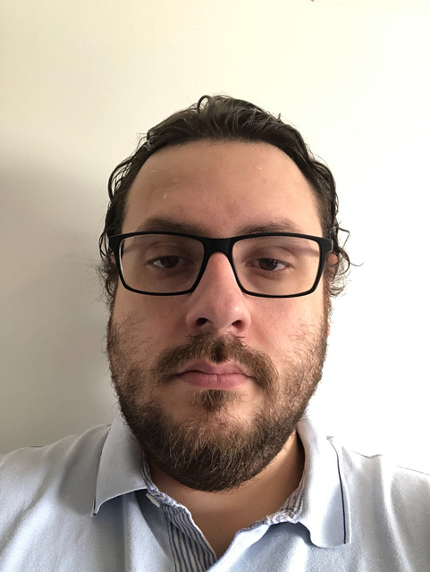

MEET THE TEAM
PROFESSIONAL MEDICAL AND AI DEVELOPMENT EXPERIENCE
MELISE ROCHA
LUCAS BARROS
ANASTASIIA BULATKINA
Notes:
Slide 2: Meet the Team
Speaker Notes:
"Our team combines the perfect blend of medical expertise and technical innovation:"
Lucas Barros - The Medical Authority:
15 years as a practicing physician
Conducts 20+ telemedicine consultations daily
Experiences this problem firsthand every single day
Backend developer - bridges clinical needs with technical solutions
"I'm not just building a product, I'm solving my own daily frustration"
Melise Rocha - The AI Expert:
Biomedical engineer with 3+ years in AI development
Leading our chatbot development and natural language processing
Understands both healthcare workflows and AI capabilities
Ensuring our solution is clinically relevant and technically robust
Anastasiia Bulatkina - The Business Strategist:
Computer science background with business operations focus
Managing frontend development and user experience
Handling business development and market strategy
Ensuring our solution is both user-friendly and commercially viable
Team Advantage:
"We're not outsiders trying to fix healthcare - we ARE healthcare, enhanced by technology."

Slide 3

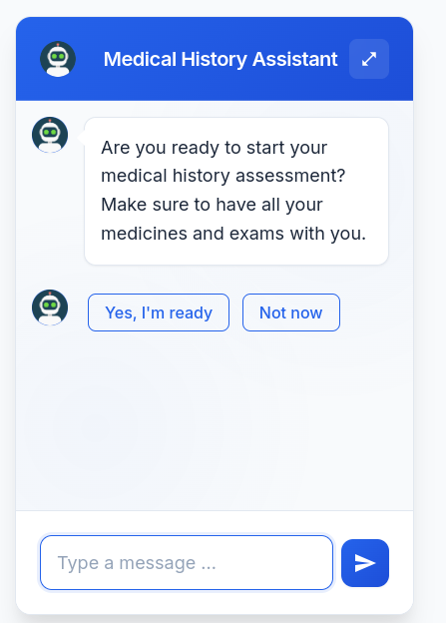
WHAT ARE WE DOING?
PRE-ANAMNESIS CHATBOT
COLLECT, ORGANIZE AND INTEGRATE CORE PATIENT INFORMATION
SECURELY TRANSPARENTLY AND EFFICIENTLY
Notes:
Slide 3: What Are We Doing?
The Vision Statement:
"PRAANA is an AI-powered pre-anamnesis chatbot that transforms patient intake through intelligent conversation."
Core Value Proposition:
COLLECT: Comprehensive medical history through natural conversation
ORGANIZE: Structure chaotic patient information into clinical-ready data
INTEGRATE: Seamlessly connect with existing EHR and telemedicine systems
Key Differentiators:
SECURELY: Full LGPD compliance and healthcare-grade security
TRANSPARENTLY: Patients understand exactly how their data is used
EFFICIENTLY: 5-10 minutes of doctor time saved per consultation
The Big Picture:
"We're not just saving time - we're enabling doctors to practice medicine instead of being data entry clerks."

Slide 4



BUT WHY?
01. TIME
02. MEMORY
03. EXAMS?
Medical appointments are constrained by time - leaving little room for story taking.
Patients often struggle to recall critical information on the spot.
Many arrive unprepared, without medical reports or exams.
There are significant gaps in efficiency, accuracy and preparedness- gaps that
this solution is designed to close
Notes:
Slide 4: But Why? - The Problem
Problem Validation - Paint the Picture:
"Every day, 500,000 Brazilian physicians lose 5-10 minutes per consultation waiting for patients to find basic information."
TIME Crisis:
Medical appointments limited to 10-20 minutes
Up to 50% wasted on information gathering
Doctors become frustrated, patients feel rushed
Actual medical care gets compressed into remaining time
MEMORY Challenge:
Patients forget medication names and dosages
Medical history becomes fragmented and incomplete
Critical information like allergies or family history overlooked
Stress of consultation makes recall even harder
EXAMS Nightmare:
40% of patients never send promised exam results
Forgotten passwords waste consultation time
Doctors make decisions with incomplete information
Follow-up appointments needed for basic data collection
The Scale:
"This affects 6,000 private clinics and 120+ telemedicine platforms daily. It's not just inconvenient - it's a systemic crisis affecting healthcare quality. And this problem came from a personal journey where our Physician Lucas Barros faced it Daily!"

Slide 5


TESTIMONIALS
Lidiane de Castro
Marcelo Morato
“Waiting for patients to look at their medicines boxes or call relatives takes a lot of time from me to look at their chief complaint.”
“Patients almost never remember their passwords to access online exams. They always send it to me later!”
Notes:
Dr. Lidiane de Castro - Telemedicine Specialist:
"This quote represents the universal experience of Brazilian physicians. Password management isn't a minor inconvenience - it's a daily barrier to effective healthcare delivery."
Dr. Marcelo Morato - Primary Care:
"Notice how he mentions the 'chief complaint' - that's the actual medical problem the patient came to solve. Currently, we spend most of our time on logistics instead of medicine."
Credibility Points:
These aren't isolated complaints - they're systemic issues
Both doctors immediately understood our solution's value
Representative of the broader medical community's frustration
Validates our problem-solution fit from actual practitioners
Market Validation:
"When practicing physicians immediately say 'this would revolutionize my practice,' we know we're solving a real problem."

Slide 6
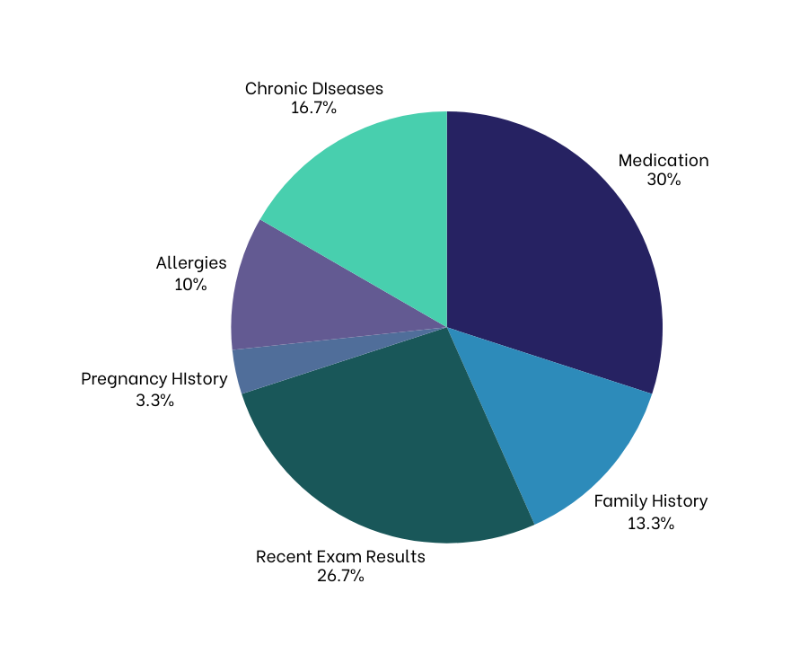
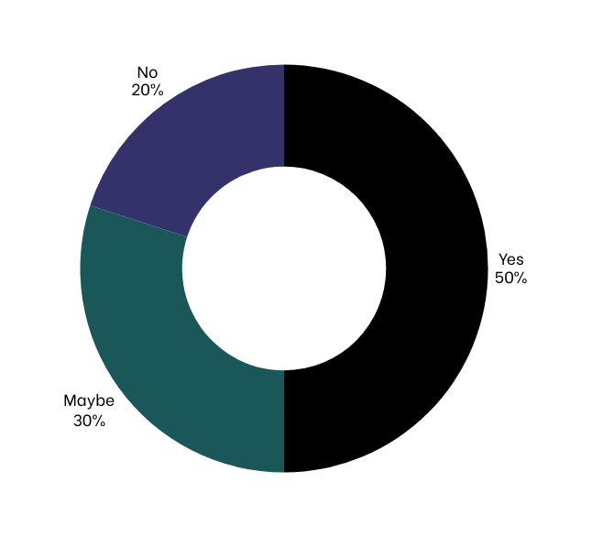
INTERVIEWS
Doctors
What do you want to see?
Willingness to Test
Notes:
Slide 6: Interviews - Doctors
Research Methodology:
"We conducted structured interviews with 10 practicing physicians across different specialties to validate our assumptions."
Willingness to Test - 50% Ready:
50% said "Yes" - ready to test immediately
30% said "Maybe" - interested but cautious
20% said "No" - satisfied with current methods
Industry standard for new healthcare technology adoption: 10-15% early adopters
Our 50% readiness rate is exceptional and indicates strong market demand
Priority Information Ranking:
Medications (30%) - Critical for drug interactions and treatment planning
Recent Exam Results (26.7%) - Essential for diagnosis and monitoring
Chronic Diseases (16.7%) - Affects all treatment decisions
Family History (13.3%) - Important for genetic risk assessment
Allergies (10%) - Potentially life-saving information
Pregnancy History (3.3%) - Relevant for specific patient populations
Strategic Insight:
"This data shaped our conversation flow - we prioritize high-value information first, ensuring we capture what doctors need most."

Slide 7
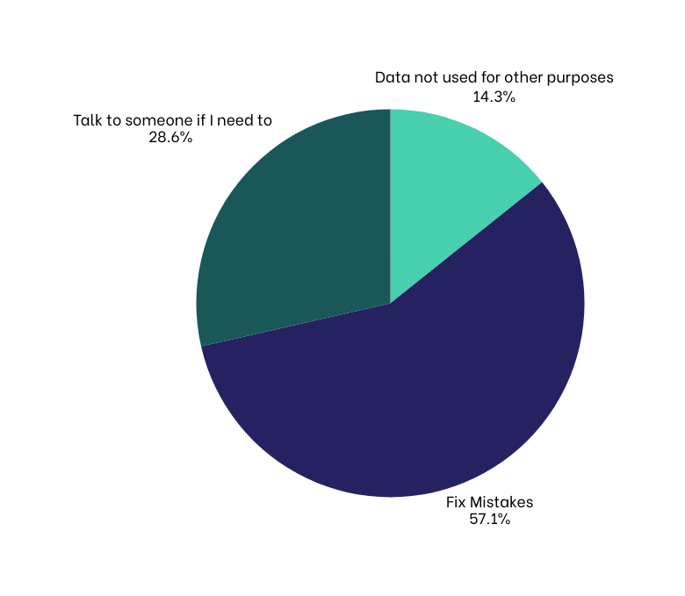
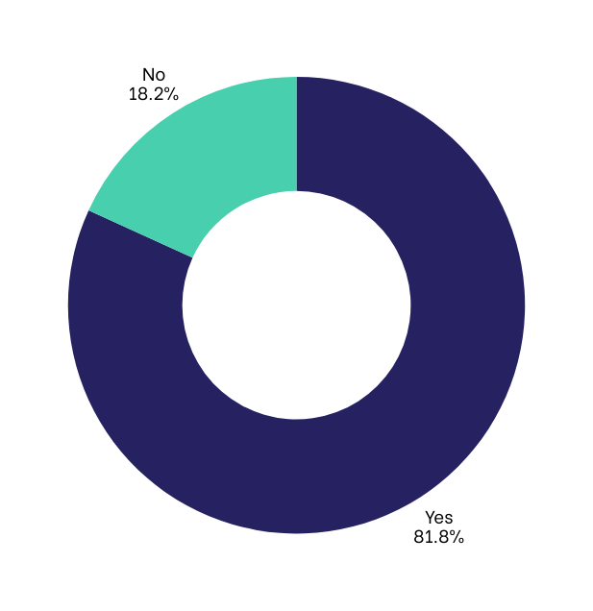
INTERVIEWS
Patients
Do you prefer the chatbot over a form?
What do you prioritize?
Notes:
Slide 7: Interviews - Patients
Patient Preference - 81.8% Prefer Chatbot:
"This is remarkable validation. Patients don't just tolerate our solution - they actively prefer it over traditional forms."
Why Patients Love It:
Conversational interface feels natural and supportive
Can take their time without feeling rushed
Guidance through complex medical terminology
Ability to pause and gather information as needed
No judgment for not remembering details immediately
Patient Priorities:
Fix Mistakes (57.1%) - Patients want control over their data accuracy
Talk to Someone (28.6%) - Human backup for complex situations
Data Protection (14.3%) - Privacy and security concerns
Business Impact:
"High patient satisfaction leads to better completion rates, more accurate data, and positive word-of-mouth marketing."

Slide 8
WHAT IS ALREADY HERE?
FEATURE | OUR CHATBOT | PATIENTINTAKE.AI | INFERMEDICA
Portuguese Language | ✅ Native AI | ❌ English only | ⚠️ Limited PT
Conversational Interface | ✅ Full AI | ✅ AI Chatbot | ✅ AI Chatbot
Medical History | ✅ Comprehensive | ✅ Structured | ⚠️ Symptom
Brazilian Market | ✅ | ❌ US-focused/Frontdesk | ⚠️ Global API
LGPD Compliance | ✅ | ❌ HIPAA only | ⚠️ GDPR
Notes:
Our Unique Position:
"We're the only solution specifically designed for pre-anamnesis collection in Portuguese for the Brazilian market. We are also the only ones doing it with easy langauge for patienrs"
Competitive Comparison:
PatientIntake.ai (Frontdesk):
Strengths: Established US market presence, proven AI capabilities
Fatal Weakness: English-only, designed for US healthcare system
Market Share in Brazil: 0%
Why We Win: Native Portuguese, Brazilian healthcare understanding
Infermedica:
Strengths: Global reach, advanced symptom checking
Weaknesses: Symptom-focused, not pre-consultation intake
Limited Portuguese support, not Brazil-specific and was built for Front Desk Users with Strong medical language.
Why We Win: Purpose-built for intake, not general triage
Key Differentiators:
✅ Native Portuguese AI - Understands Brazilian medical terminology
✅ Conversational Interface - Natural dialogue, not form-filling
✅ Comprehensive Medical History - All 13 essential fields
✅ Brazilian Market Focus - LGPD compliance, local healthcare workflows
✅ LGPD Compliance - Built for Brazilian privacy laws from day one
Competitive Moat:
"International competitors would need to rebuild their entire platform for Brazil. Local competitors lack our AI sophistication and medical expertise."

Slide 9
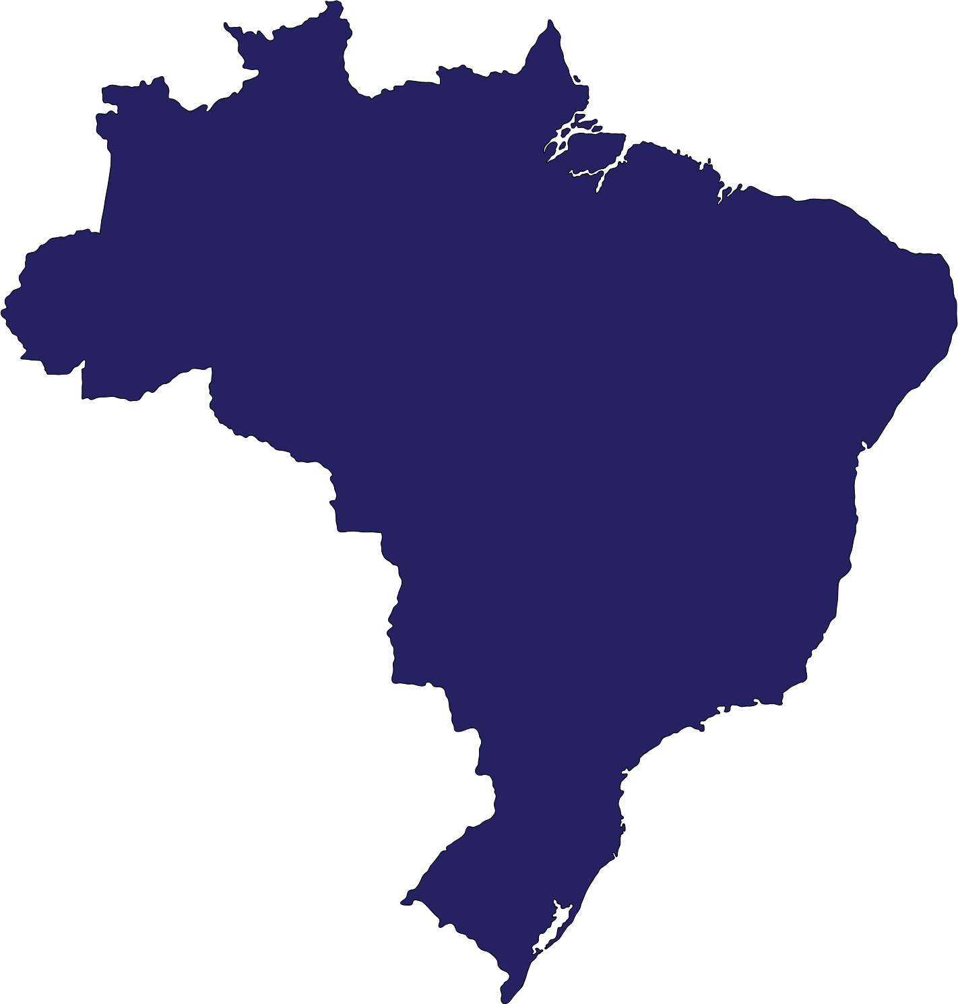



MARKET SIZE
01. TAM
SOM
US $161B spent in 2024. [1]
< 5% in small cities
20-30% in big cities [6]
02. SAM
04. Timeline
Telemedicine: $ 1.98B - 100 companies [2]
Healthcare clinics: 6000 [3]
Physicians: 500.000 [4]
Telemedicine expected CAGR (5 years ): 19.3% [5]
Notes:
Slide 9: Market Size - TAM SAM SOM
Total Addressable Market (TAM) - $161B:
"Brazil's total healthcare spending represents Latin America's largest market - larger than many European countries."
Serviceable Addressable Market (SAM) - $1.98B:
Telemedicine market growing at 19.3% CAGR
100+ telemedicine companies active
Digital health adoption accelerating post-COVID
Government investing $200M in healthcare digitalization
Serviceable Obtainable Market (SOM):
6,000 healthcare clinics (our primary target)
500,000 physicians (potential end users)
120+ telemedicine platforms (distribution channels)
Market Penetration Reality:
Small cities: <5% digital adoption (huge growth opportunity)
Large cities: 20-30% adoption (early adopter markets)
Our strategy: Start with digitally-ready urban markets, expand to smaller cities
Conservative Projections:
Year 1: 0.02% penetration = $9,000 revenue
Year 2: 0.2% penetration = $90,000 revenue
Year 3: 0.8% penetration = $360,000 revenue
Even at <1% market share, we achieve substantial revenue
Growth Catalysts:
"Three forces accelerate our opportunity: aging population increasing demand, physician shortage driving efficiency needs, and regulatory support for telemedicine."

Slide 10
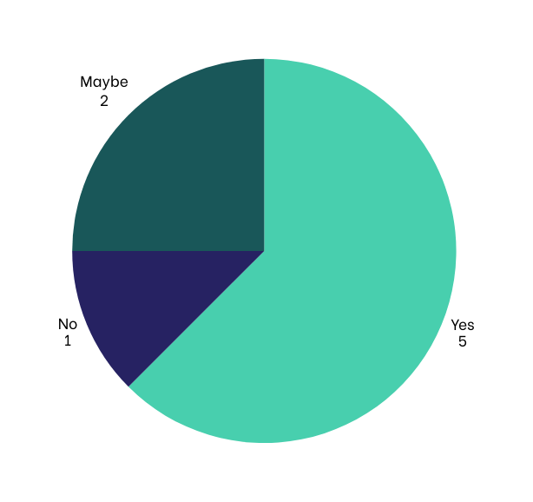

PRICING
TIER | PRICE | INCLUDING
Starter | $50/month | 100 patients
Professional | $150/month | 500 patients
Enterprise | $300/month | Unlimited
Customization | $10K-30K fee
Is it feasible for you to pay?
Based on the average price of $3000 per month for EHR systems in Brazil.
$4.8 million/year
Notes:
Slide 10: Pricing Strategy
Pricing Philosophy:
"We priced PRAANA at 5-10% of typical EHR system costs ($3,000/month) while delivering immediate, measurable value."
Tier Structure:
Starter ($50/month):
Target: Solo practitioners, small clinics
100 patients/month capacity
Basic integration and email support
Value Proposition: Time savings pay for subscription in 2-3 saved consultations
Professional ($150/month):
Target: Growing clinics, telemedicine platforms
500 patients/month capacity
Priority support and API access
Value Proposition: Efficiency gains support clinic growth
Enterprise ($300/month):
Target: Large clinics, hospital networks
Unlimited capacity
24/7 support and custom workflows
Value Proposition: Scalable solution for high-volume operations
Market Validation:
5 respondents said "Yes" to pricing (62.5%)
2 said "Maybe" (25%)
1 said "No" (12.5%)
87.5% find pricing acceptable - strong market validation
Revenue Projections:
Conservative average: $150/month per customer
Break-even: 20 customers
Year 2 target: 50 customers = $90,000 ARR
Year 3 target: 200 customers = $360,000 ARR

Slide 11
ASSOCIATED COSTS
Annually
AREA | SUBTOTAL
Infrastructure | $18,588
Employee | $682,500
Marketing | $94,000
Consulting | $20,000
TOTAL | $815,088
Notes:
Slide 11: Associated Costs
Annual Operating Costs: $815,088
Infrastructure ($18,588):
Cloud hosting, database management
Security and compliance tools
AI processing costs (variable with usage)
Email and communication services
Employee ($682,500):
Expenses with developers, people to answer customer questions.
Marketing ($94,000):
Digital marketing campaigns
Conference participation
Content creation and SEO
Partnership development
Consulting ($20,000):
Legal compliance (LGPD)
Healthcare regulations
Business development advisory

Slide 12
HOW CAN WE REALLY JOIN THE MARKET?
AREA | MAJOR PLAYERS
EHR Systems (Our biggest Focus) | MEMED Iclinic
Public Healthcare System (SUS) | They have their own EHR
Notes:
EHRS are our biggest focus for now because they are easier to integrate with it. Although not the biggest player in Brazil.
1. Memed - Brazil's Largest EHR Provider
Key Talking Points:
Market Position: Memed is the biggest EHR provider in Brazil with extensive market penetration
Partnership Infrastructure: They have a dedicated partnerships team specifically for healthcare integrations
Existing Partnership Model: Already partners with multiple Brazilian startups for:
Medical data summary generation
Medicine recommendations
Clinical decision support tools
Partnership URL: https://memed.com.br/parceiro-software/
Our Value Proposition to Memed:
"We enhance their existing patient summary functionalities with conversational AI"
"Their doctors get better data quality through our pre-consultation intake"
"We reduce their support burden by handling routine patient questions"
2. iClinic - Scheduling Integration Leader
Key Talking Points:
Core Strength: Established online appointment scheduling functionality
Integration Opportunity: We integrate our pre-consultation intake with their appointment confirmation system
Workflow Enhancement: When patients confirm appointments through iClinic, they automatically receive our intake questionnaire
Data Flow: Patient responses feed directly into iClinic's patient summary system
3. SUS
150 million patients served by SUS (70-84% of Brazil's population)
Existing digital infrastructure ready for enhancement, not replacement
Integration strategy with e-SUS APS (EHR) and Meu SUS Digital (patient app)
https://sisaps.saude.gov.br/sistemas/esusaps/

Slide 13
THANKS!
QUESTIONS?

Slide 14
REFERENCES
[1]: Insights10 - Brazil Artificial Intelligence in Healthcare Market Report 2022 to 2030
https://www.insights10.com/report/brazil-artificial-intelligence-ai-in-healthcare-market-analysis/
[2]: https://www.imarcgroup.com/brazil-telemedicine-market
[3]: https://www.trade.gov/country-commercial-guides/brazil-healthcare
[4]: https://www.commonwealthfund.org/international-health-policy-center/countries/brazil
[5]: Digital health penetration projection - Market research indicates growth trajectory for digital health adoption in Brazil reaching 15-20% by 2030
[6]: https://www.jmir.org/2023/1/e42483/

